Slide 1
DATABASE DESIGN AND IMPLEMENTATION
ROAD SIGN AND ROAD STATE MOBILE NOTIFICATION APP
CAM WE-GO

Slide 2
01
ENLIGHTENMENT

Slide 3
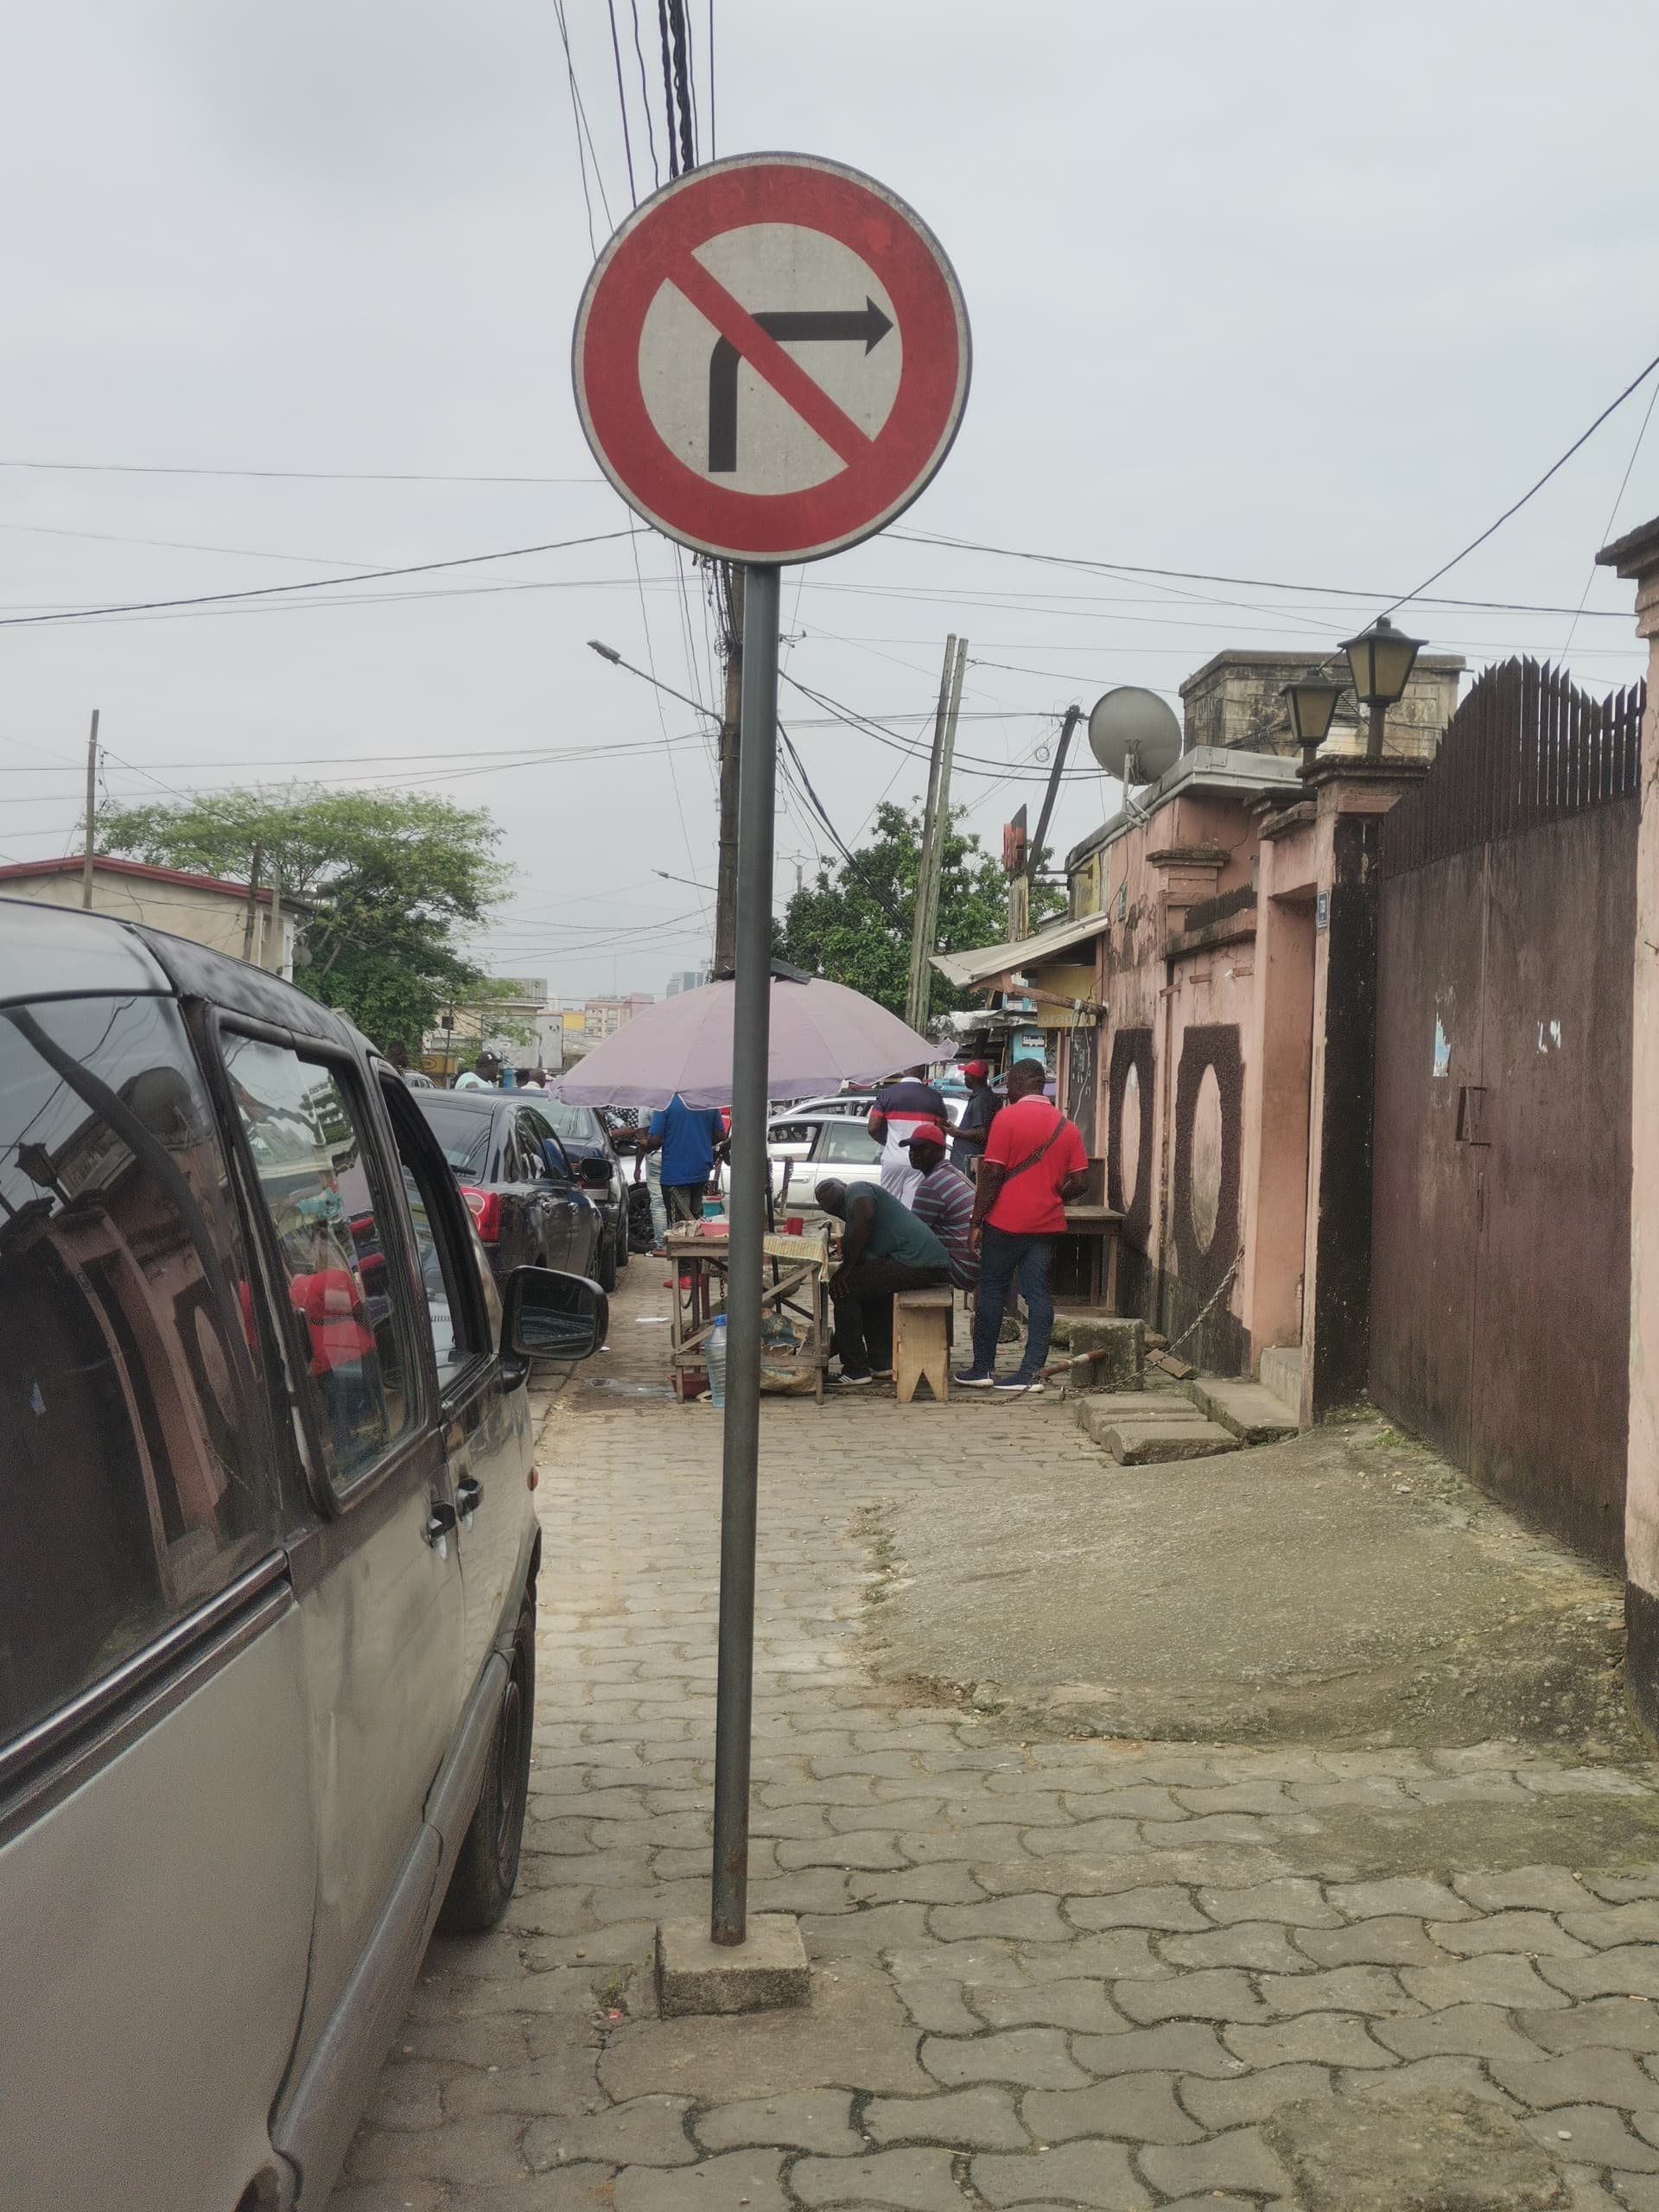
ENLIGHTENMENT
ROAD SIGN
NAME
MEANING
CATEGORY

Slide 4
ENLIGHTENMENT
ROAD SIGN
NAME
MEANING
CATEGORY
POST
LOCATION

Slide 5
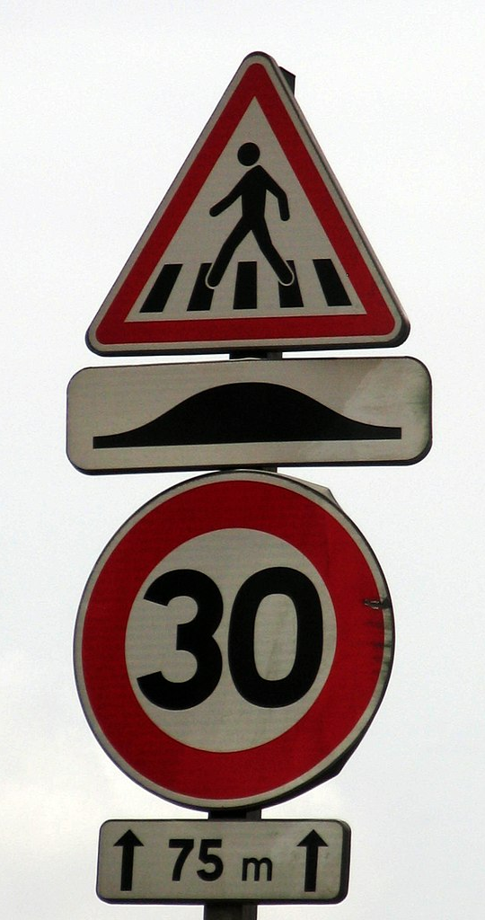
ENLIGHTENMENT
MULTI ROAD SIGN
POST

Slide 6
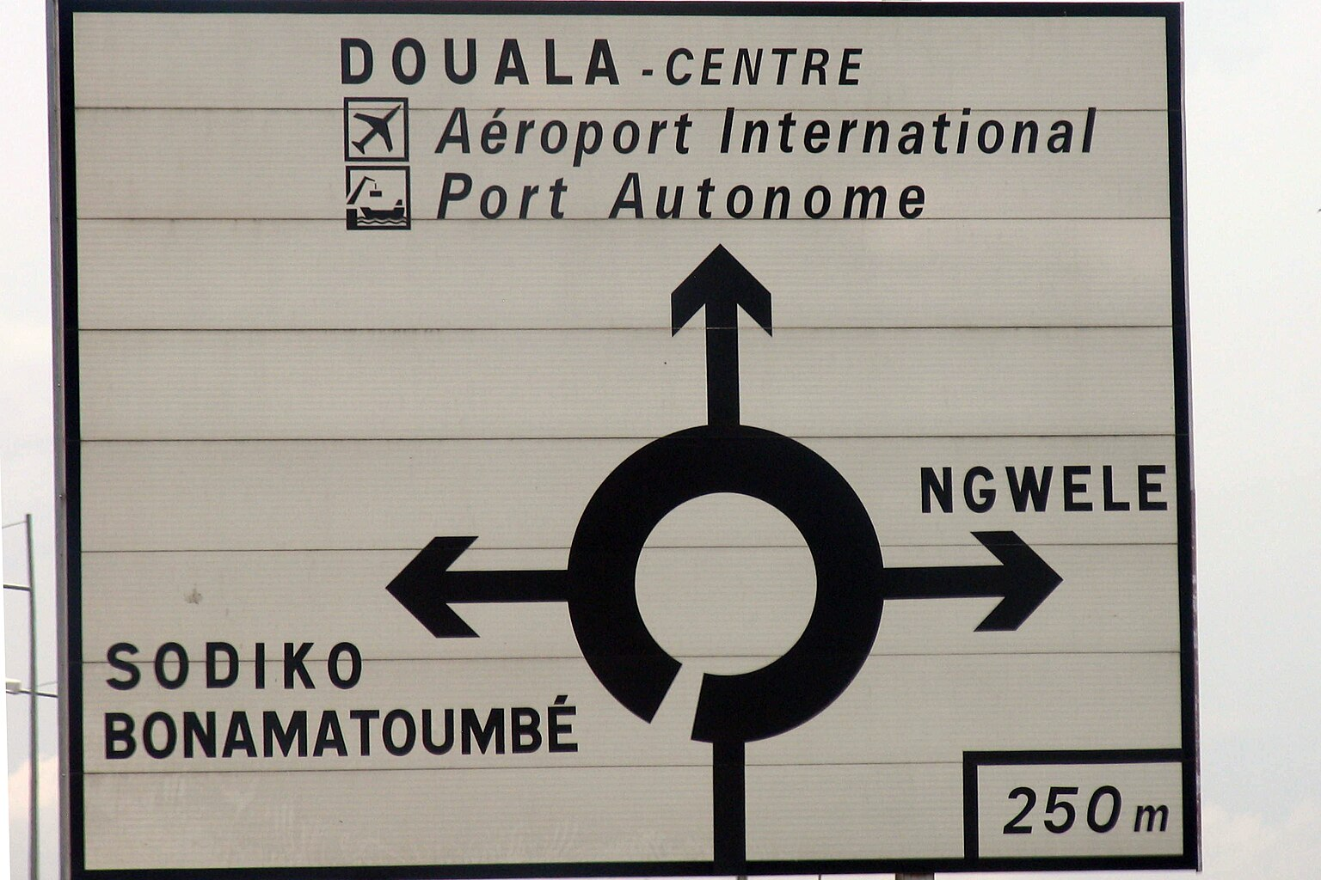
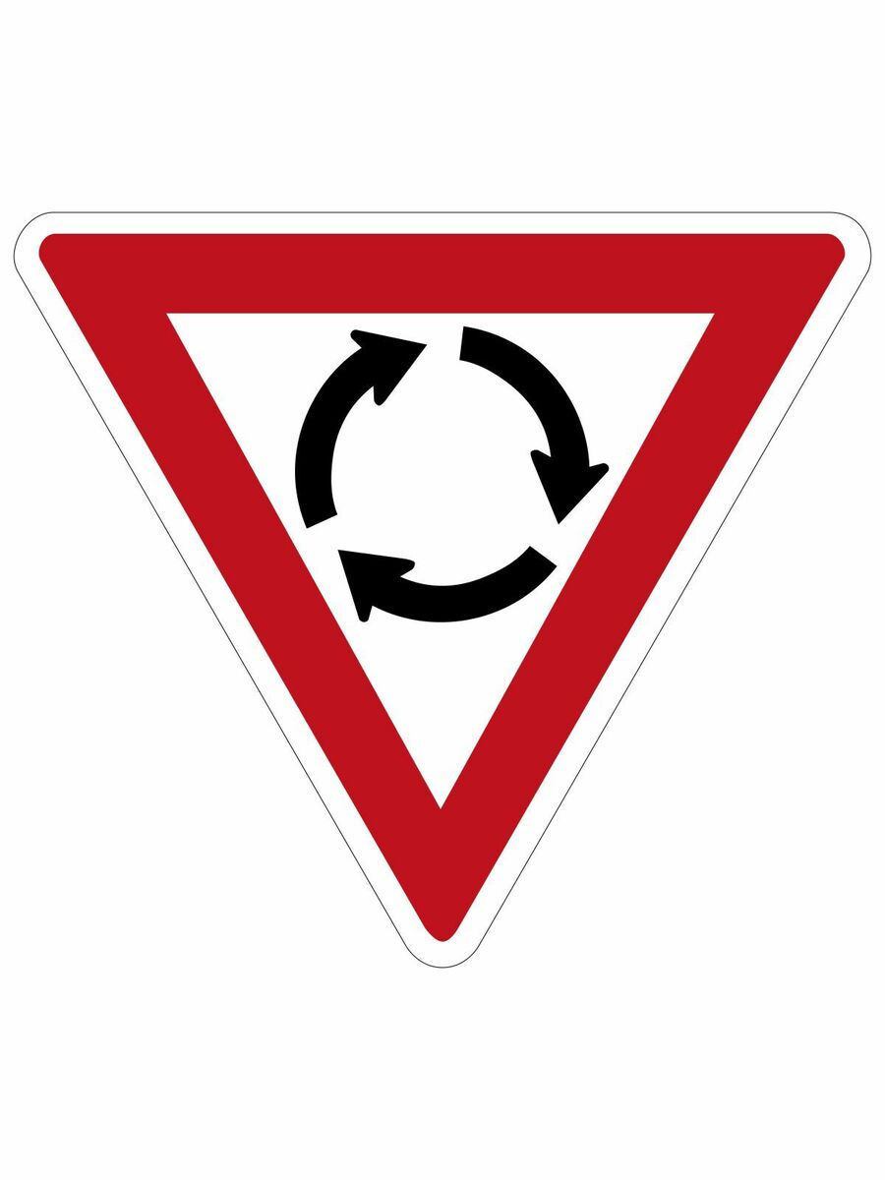
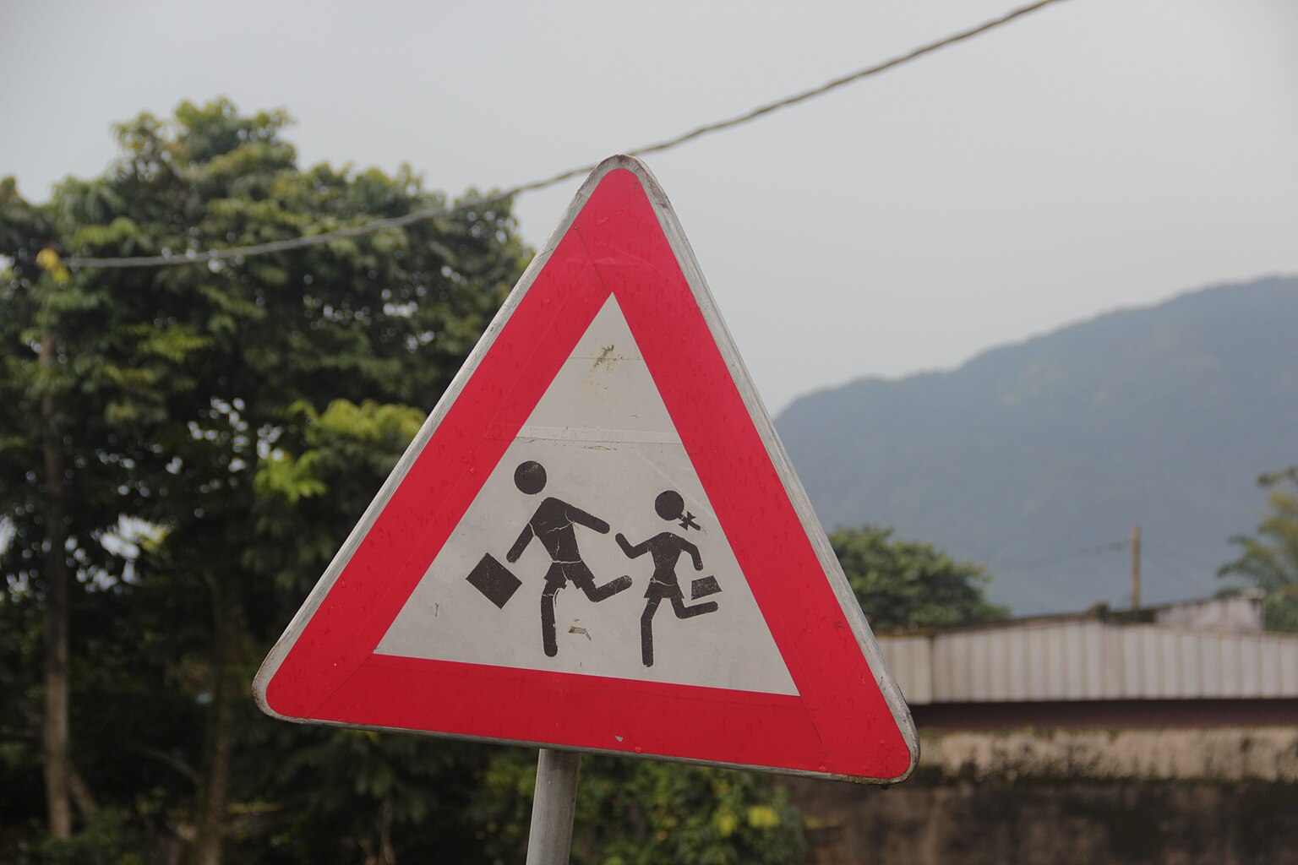
01
02
REGULATORY
INFORMATIVE
03
WARNING
CATEGORIES
04
GUIDE

Slide 7
Database Design Process
Determined the purpose of our database
Find and organized the information required
01
02
04
03
Divide the information into tables
Designed the ER-Diagram

Slide 8
DATABASE DESIGN PROCESS
02

Slide 9
01
02
03
Store user data
Store road sign / state info
Store User report
PURPOSE

Slide 10
DATA SOURCES
GOOGLE MAPS API
USER INTERFACE
APP
WEATHER API
ROAD SIGN DATABASE

Slide 11
DATA SOURCES
USER INTERFACE
GOOGLE MAPS API
User credentials
User preferences
Navigation data
Road sign info
Road state info
ROAD SIGN DATABASE
WEATHER API
Weather data
Road sign data

Slide 12
ENTITY RELATIONSHIP DIAGRAM
03

Slide 13
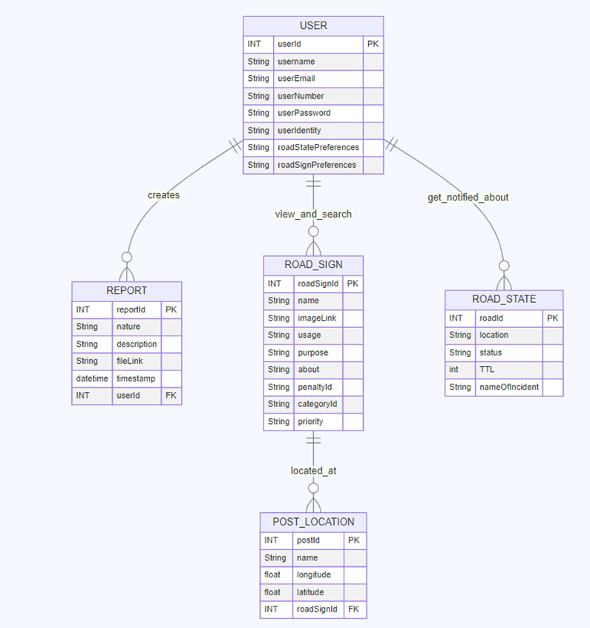
ER DIAGRAM

Slide 14
ER DIAGRAM

Slide 15
04
IMPLEMENTATION

Slide 16
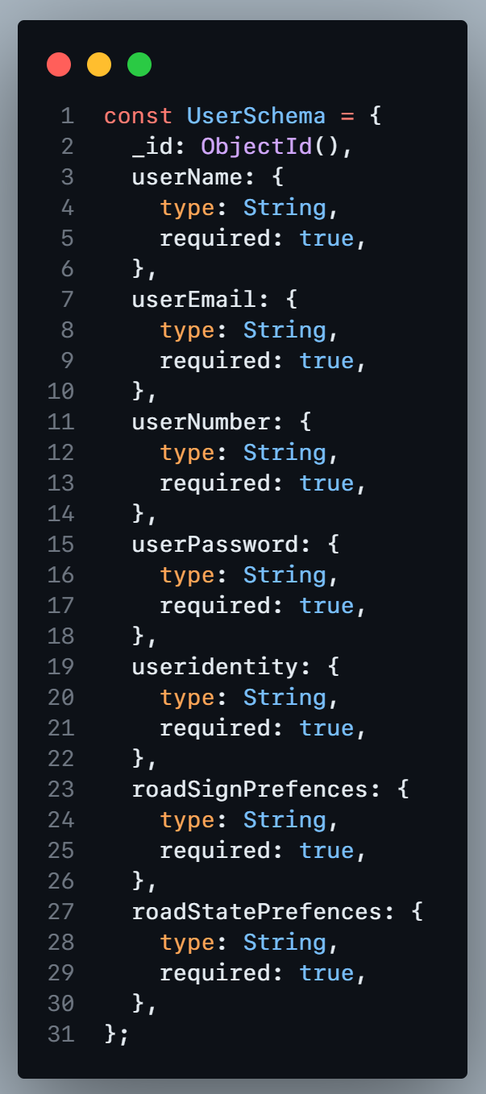
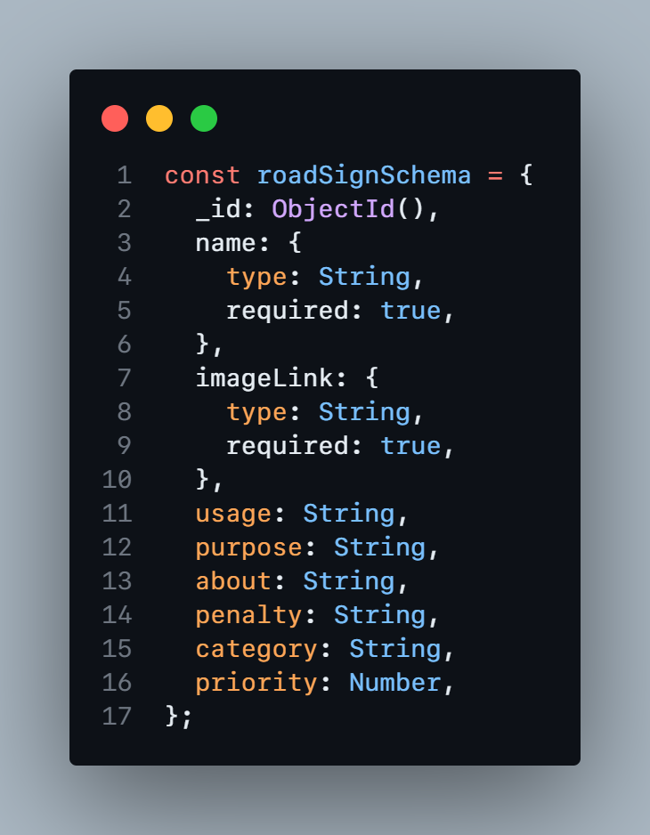
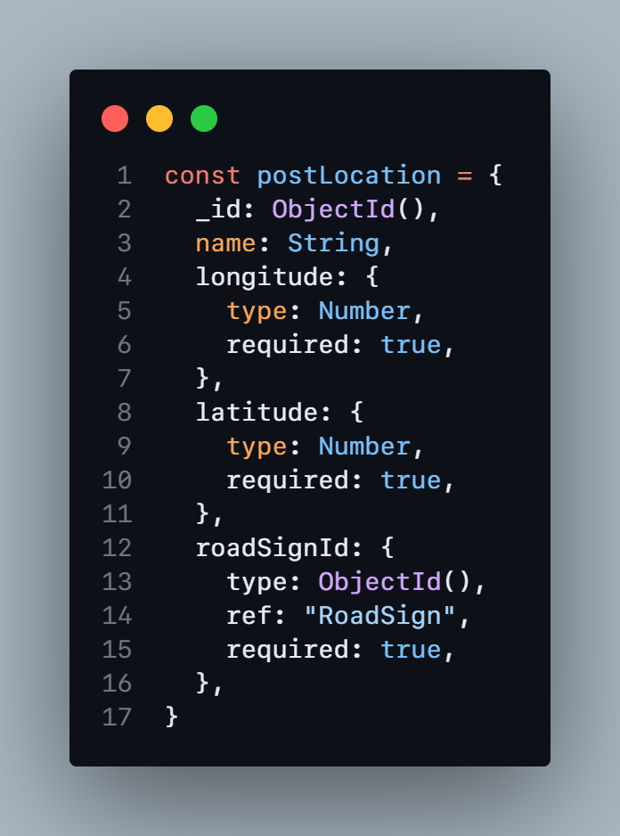
IMPLEMENTATION

Slide 17
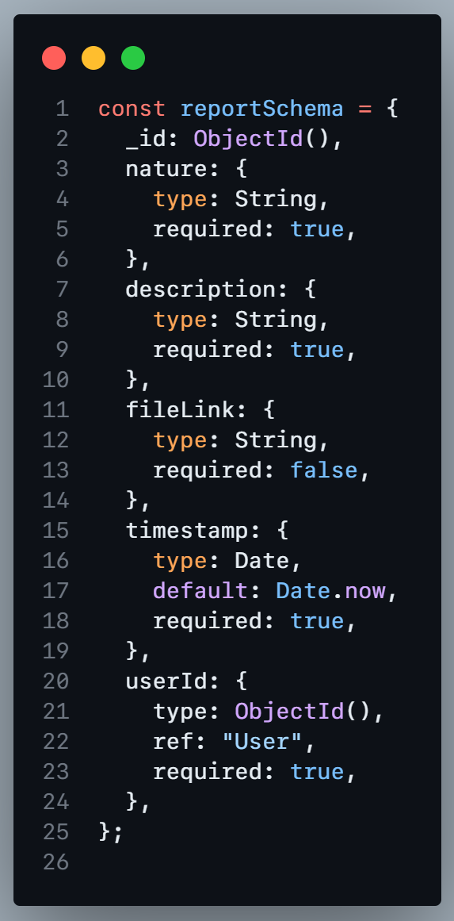
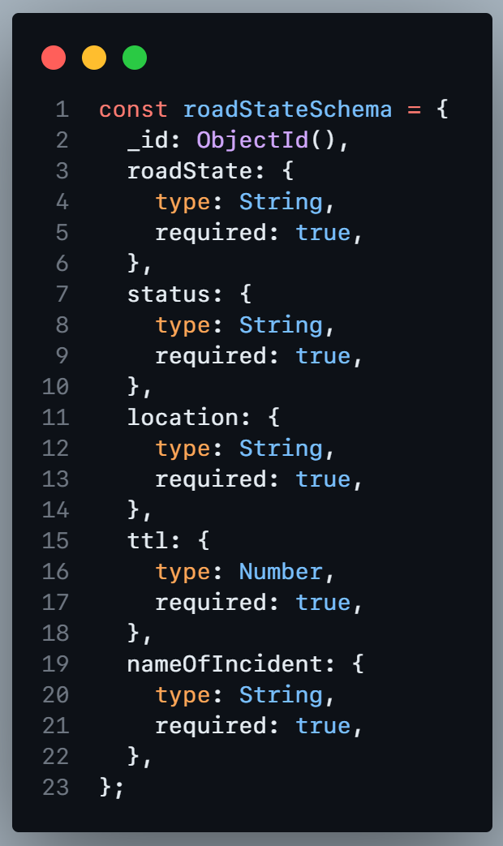
IMPLEMENTATION

Slide 18
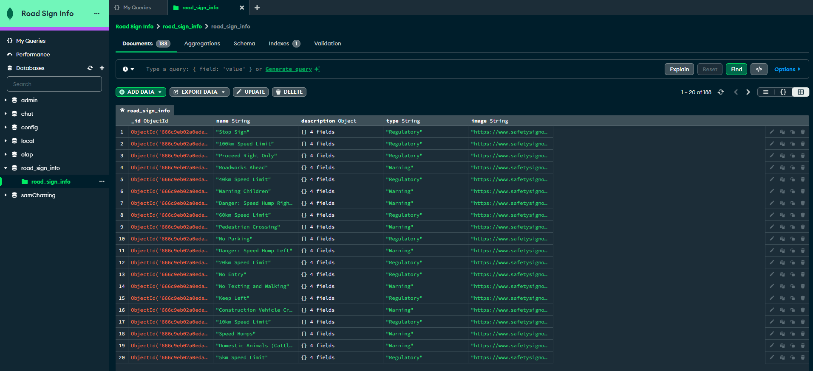
IMPLEMENTATION

Slide 19
OTHER FACTORS CONSIDERED
05

Slide 20
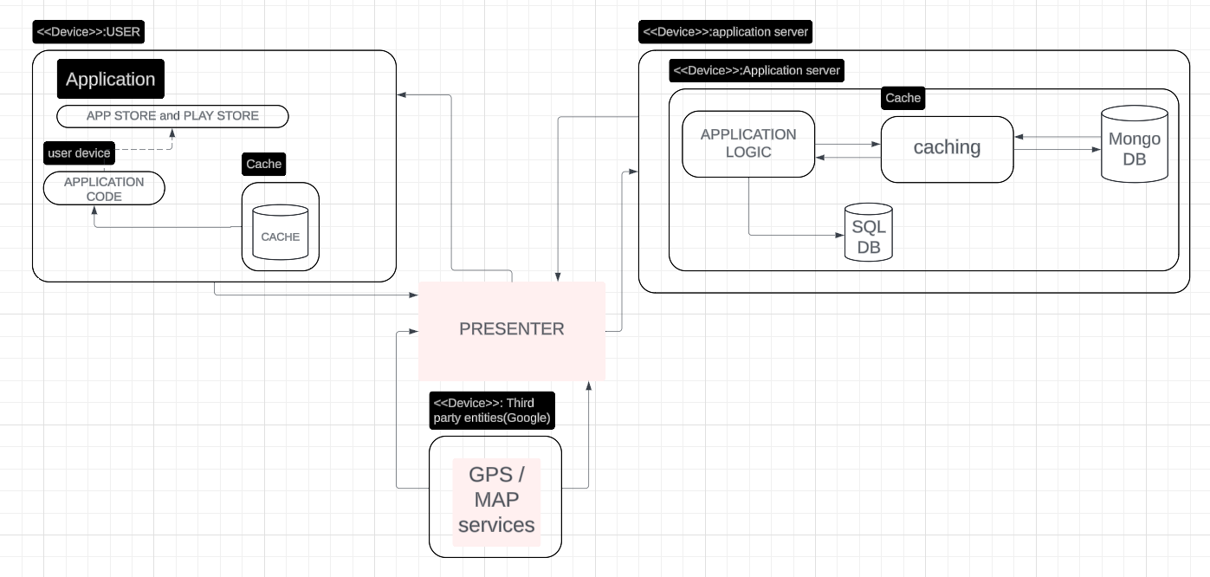
OTHER FACTORS

Slide 21
OTHER FACTORS
Speed
Security
Documentation

Slide 22
OTHER FACTORS

Slide 23
THANK YOU!
PRESENTED BY GROUP 3

